Slide 1
ML Project Process
Startup Investment Outcome — Supplementary Visualizations
54,294
40
39,802
46
Startups
Raw Features
After Cleaning
Engineered Features
EDA → Preprocessing → Imbalanced Data → Feature Selection → Modeling

Slide 2
EDA · Target Variable Distribution
⚠ Severe imbalance: operating is 16× more frequent than closed → requires resampling

Slide 3
EDA · Missing Value Profile
Preprocessing Decisions
status null (11.4%)
Drop rows — no label
funding_total_usd (24.7%)
Impute from rounds_sum; drop if 0
founded_year/month/qtr (29%)
Parse from founded_at; median impute
market (16.3%)
Fill 'Unknown' → target encode
country_code (18.7%)
Fill 'Unknown' → geo_cluster
state_code (44.4%)
Drop — subsumed by geo_cluster

Slide 4
EDA · Funding Rounds — Participation & Impact
Median funding rounds: acquired = 2.0 | operating = 1.0 | closed = 1.0 → acquired companies raise more rounds

Slide 5
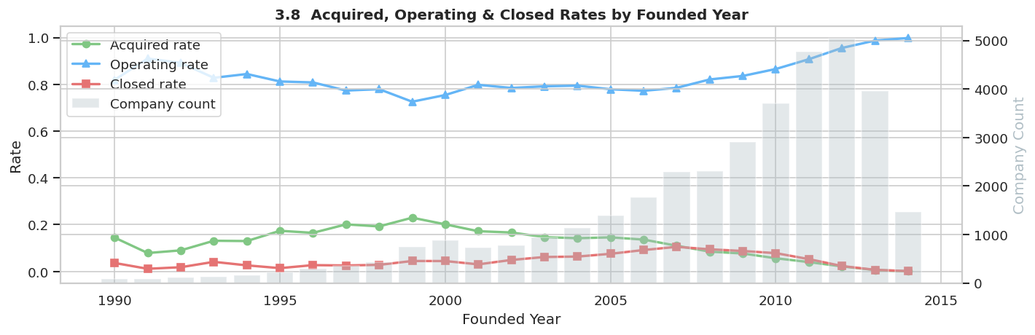
EDA · Status by Year

Slide 6
EDA · Geographic Signals — Acquisition vs Closure Rates
geo_cluster engineered: Silicon Valley / NY / Boston / Seattle / LA / USA-Other / country code / Unknown

Slide 7
Preprocessing · Stratified Train / Val / Test Split
sklearn Pipeline (11 steps — fit on train only, applied to val & test):
DTypeConverter → DateFeatureExtractor → CountryFiller → MarketFiller
GeoClusterCreator → FundingLogTransformer → RoundBinarizer
FundingTimelineCalculator → TargetEncoder → DateMedianImputer → ColumnDropper
Result: 46 features — 0 nulls in all splits

Slide 8
Imbalanced Data · Resampling Strategy Comparison (Validation Set)
Selected: ROS (Macro F1 = 0.4520) — best balance of minority recall without destroying operating F1. After ROS: 24,098 samples per class (72,294 total).

Slide 9
Feature Selection · ANOVA F-Test — Top Features
All 32 features significant at α = 0.05 (p < 0.05)

Slide 10
Feature Selection · Permutation Feature Importance (Random Forest, Validation Set)
log_funding_total_usd (0.057) + founded_year (0.053) + log_venture (0.052) are the three most impactful features

Slide 11
Feature Selection · Multi-Method Vote — Final Feature Set
Threshold: ≥5 votes → 10 features selected (from 32) | Methods: ANOVA + Lasso + SVM + RandomForest + GradientBoosting + Ridge + ForwardSelection

Slide 12
Modeling · All 20 Combinations — Macro F1 on Validation Set
🥇 Best
Random Forest + SMOTETomek
Macro F1: 0.4189 | Accuracy: 73.7%
🥈 2nd
Random Forest + SMOTE
Macro F1: 0.4148 | Accuracy: 74.4%
🥉 3rd
Random Forest + ROS
Macro F1: 0.3944 | Accuracy: 58.4%
Selected features (10): funding_rounds, log_funding_total_usd, log_venture, founded_month,
log_debt_financing, has_round_A/B/C, market_category_enc_closed, geo_cluster_enc_acquired

Slide 13
Modeling · Final Evaluation — Random Forest + ROS (Test Set)

Slide 14
Final Model · Feature Importances (Random Forest + ROS)
Funding amount (log) + geographic cluster drive most of the model's predictive power
Features Selected
Best Macro F1 (val)
Test Accuracy
Test Macro F1

Slide 15
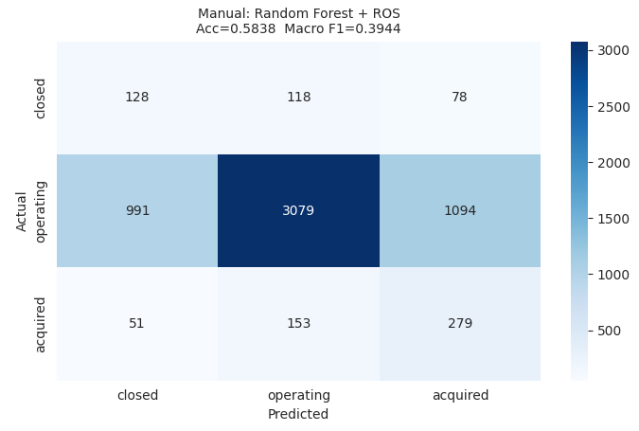
Final Model · Performance (Random Forest + ROS)
============================================================
MANUAL: Random Forest + ROS
Accuracy : 0.5838
============================================================
precision recall f1-score support
closed 0.11 0.40 0.17 324
operating 0.92 0.60 0.72 5164
acquired 0.19 0.58 0.29 483
accuracy 0.58 5971
macro avg 0.41 0.52 0.39 5971
weighted avg 0.82 0.58 0.66 5971

